Slide 1
Today
Lecture 20: The dc SQUID --- operation and applications
Discussion of dc SQUIDs in two parts:
Models
Operation and applications
Next time
Lecture 21: Quantum information

Slide 2
Final project
27 students
6 groups of 4-5
Explore a topic --- make a set of slides
12 minute presentation on Tuesday, May 10 (last day of class)
Topics:
Conventional SC qubits vs. topological SC qubits
SC qubits vs. ion trap qubits
SC qubits vs. semiconductor qubits
Quantum Supremacy
Superconductors for Quantum Networking
Superconductors for Quantum Sensing
Quantum computing for discovery of new superconductors
Or a topic of your choosing
Very unstructured open-ended assignment
Will need to explore the internet to find interesting materials and converge on a theme and focus for your presentation
Goal is for everyone to participate --- I would suggest that your team make a plan and have each person contribute some specific component or specific slides to the presentation

Slide 3
dc SQUID
A dc SQUID consists of two junctions embedded in a superconducting loop
Φ
I_{c1}
I_{c2}
Symmetric SQUID → I_{c1} = I_{c2} = I₀
Asymmetric SQUID → I_{c1} > I_{c2}
I_{c1}+I_{c2}
Modulation reduced
Critical current (I₀)
Modulates to zero
Critical current (I₀)
I_{c1}-I_{c2}
(I_{c1}=1.5, I_{c2}=0.5)
Applied flux (Φ₀)
Applied flux (Φ₀)

Slide 4
dc SQUID w/ inductance
A finite inductance modifies the SQUID characteristic because the circulating currents generate a flux in the loop that adds to the applied flux
This is an example of “self-field effects” in which the fields from the Josephson currents cannot be ignored
Inductive SQUID
J = I₁-I₂ = circulating current
Φ = applied flux
Modulation reduced
Critical current (I_{c})
β=1
Applied flux (Φ₀)
Dependence on β

Slide 5
dc SQUID operation
A dc SQUID biased at constant current exhibits a voltage modulation wih applied magnetic flux (period in Φ₀)
I/I_{c} =
4
3.5
nΦ₀
3
Critical current (I₀)
Voltage (I_{c}R)
2.5
2
(n+½)Φ₀
1.5
1.1
Voltage (I_{c}R)
Applied flux (Φ₀)
For highest field sensitivity, bias just above I_{c}

Slide 6
dc SQUID operation
I
I
I
0
1
2
I
I
I
Flux-to-voltage transducer ---
sensitivity depends on

Slide 7
(1) Flux sensitivity
Transfer function =
depends on
estimate:
½ of total I_{c}
Typical values:
Want R large and L small
↑
limited by
β_{c}
(hysteresis)
↑
limited by
β
(flux coupling)

Slide 8
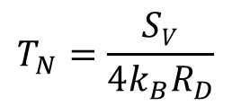
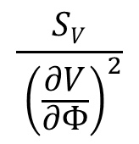






Flux resolution --- depends on noise
Voltage noise:
$$SV$$
real flux noise
$$\frac{SV}{ {\left(\frac{∂V}{∂Φ}\right)}^{2}}$$
$SΦ$ =
Is this a real flux? Some is – from noise in the circulating current, but some is only an effective noise required to give measured
Flux noise:
equivalent flux noise
Circulating current noise: $SJ$ Real noise; important for input circuits attached
$$SE=\frac{S_{Φ}}{2L}$$
$$L$$
Energy resolution:
$$E=\frac{1}{2}LI2=\frac{Φ^{2}}{2L}$$
x
$$Φ$$
x
$$T_{N}=\frac{SV}{4k_{B}R_{D}}$$
Noise temperature:
Compare to noise of a resistor at elevated temperature $T_{N}$ > $T_{ }$
SQUID characteristics (I vs. V, V vs. Φ) and the noise depends on junction parameters and bias conditions (can be calculated by phase dynamics model)

Slide 9
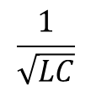


Optimization (dc SQUID) highest
trade-off between large modulation depth and noise
Parameters coupled ⇒
non-hysteretic but R large
choose L, C ⇒ R, I_{c}
(1) Signal small large
R large, I_{c}
large
⇒ C small
At
Best performance at match
means resonance structure likely in dc SQUIDs!
Noise properties:
S_{E} ~ 20k_{B}T$\sqrt{LC}$
$$\frac{1}{\sqrt{LC}}$$
Quantum limit T0:
k_{B}T ω
 ω
S$Φ$ = 20 k_{B}T L $\sqrt{LC}$
S_{E} ~ 

Slide 10
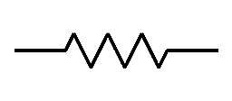
(3) Linearity --- flux-locked mode
amplifier
dc bias
INPUT
MODULATION
signal
dc
Low Pass Filter
~
MIXER
ref
dc+
ac
FEEDBACK
E

Slide 11
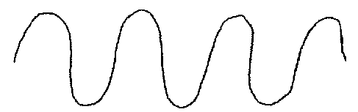
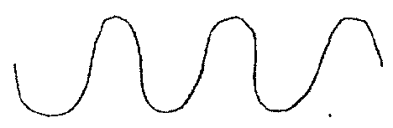
Flux-locked loop
modulation frequency (typically 100KHz - 500KHz
C
A
I
B
D
E
B
A
I
I
0
1
C
Apply ac flux modulation with amplitude
D
1
Feedback non-zero DC component (after mixer) to SQUID to keep flux-locked on
or
Measure feedback voltage/current
Sensitive to near

Slide 12
SQUID Applications
1) Galvanometer
I
M
Commercial dc SQUID:
x
x
(2) Voltmeter:
M
Need to consider intrinsic noise of SQUID and the noise from the input circuit
V
x
R
x
SQUID
input
Can achieve voltage sensitivities of < 10⁻¹⁴ V

Slide 13
(3) Voltmeter (potentiometer)
X
X
Operate as null detector with feedback:
Null current in SQUID →
X
X
Typical Values:
gain

Slide 14
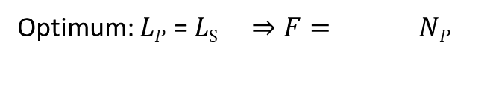

(4) Magnetometer
X
N_{p}
X
L_{p}
L_{s}
= flux per turn
Flux transformer
flux conversion
$$\left(\frac{M}{2L_{S}}\right)$$
Optimum: $LP$ = $LS ⇒F= NP$
coupling constraint
Lose some flux energy by using a flux transformer but can couple better to samples with different geometries, temperatures, fields etc.

Slide 15
Magnetometer
x
X
X
B
x
Gradiometers
x
x
x
x
x
x

Slide 16
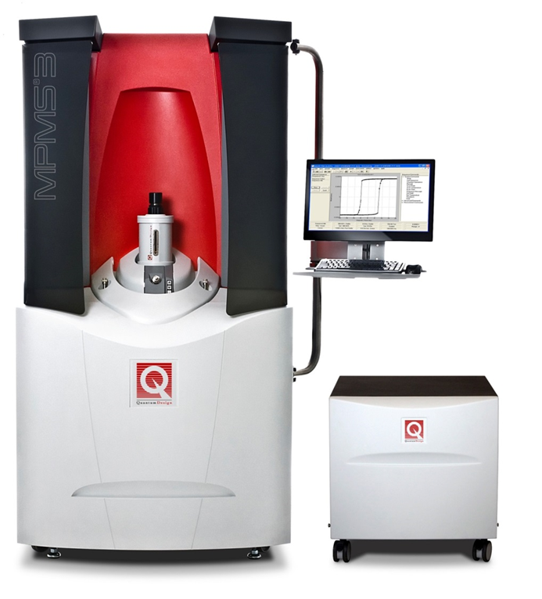
Magnetic susceptometry
x
2nd coil cancels direct field response – signal ∝ susceptibility
H
x
Commercial SQUID magnetometers
Quantum Design
Magnetic Properties
Measurement System
“Evercool”
1.8 K – 400 K
7-T Magnet
Cryocooler
Most widely-sold commercial product with a SQUID

Slide 17
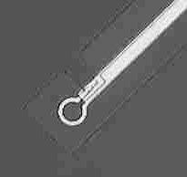
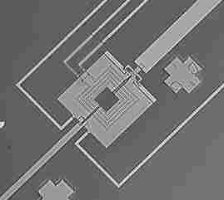
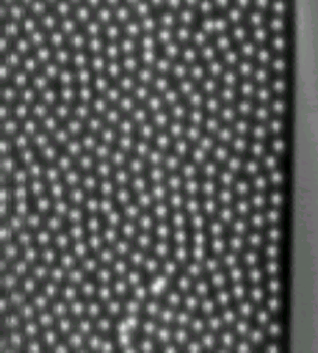
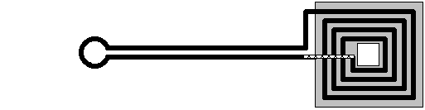
Our experience: Scanning SQUID Microscopy (SSM)
Technique developed in the 1980’s by UIUC/DVH group and IBM/Stanford.
SQUID detector scanned over surface to map the local magnetic field
x-y scan
hinge
10μm
100μm
Spatial resolution:
10μm
Flux sensitivity:
10⁻⁶ Φ₀
Square arrays
Triangle arrays
YBCO films
MoGe films

Slide 18
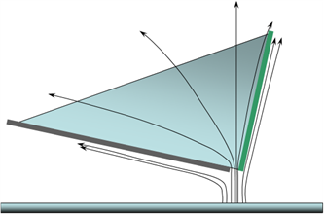
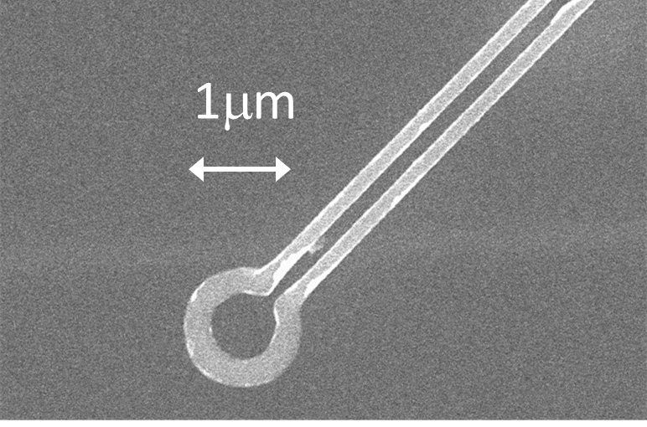
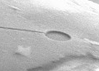

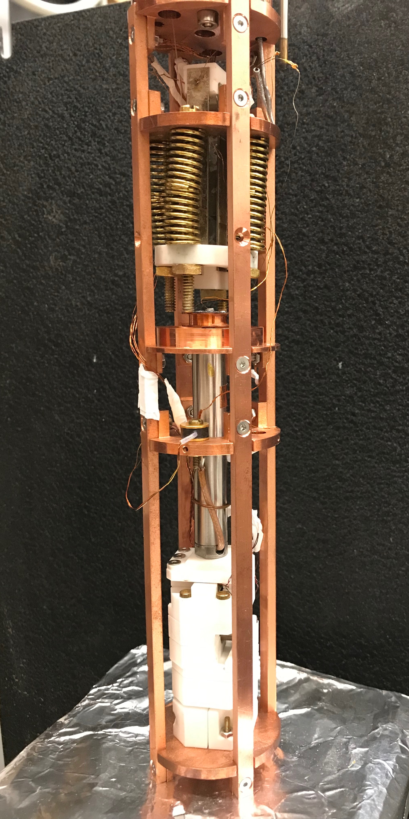
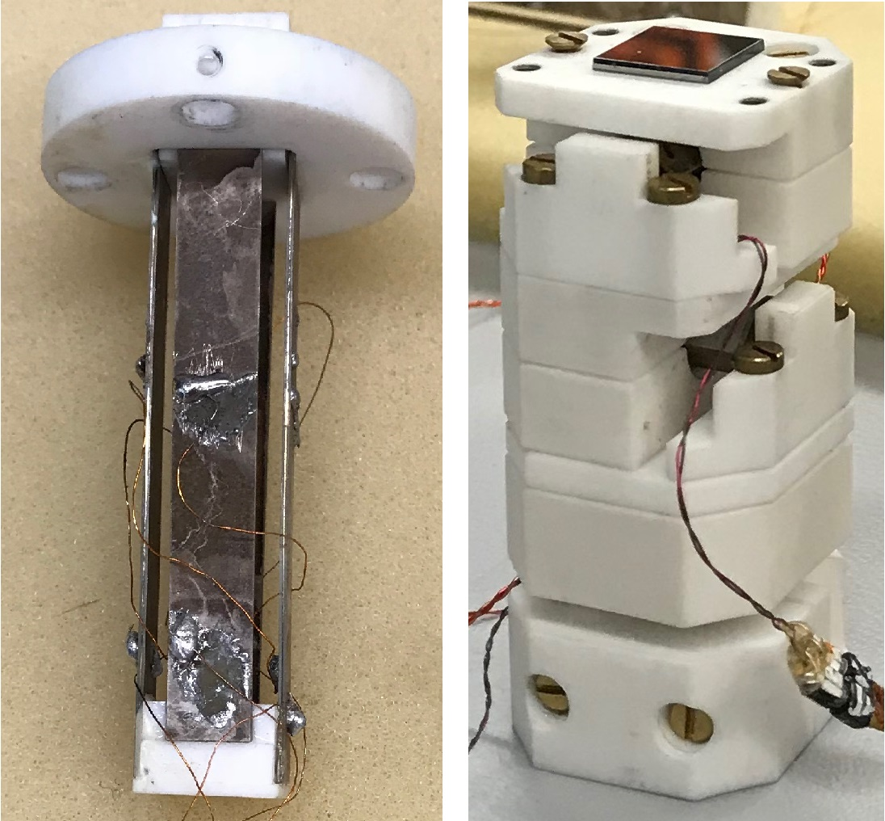
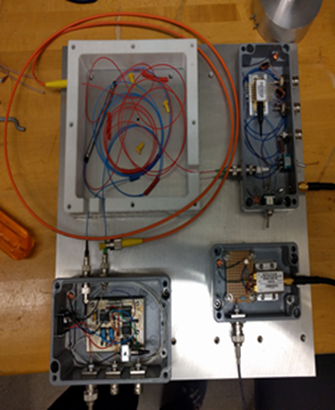
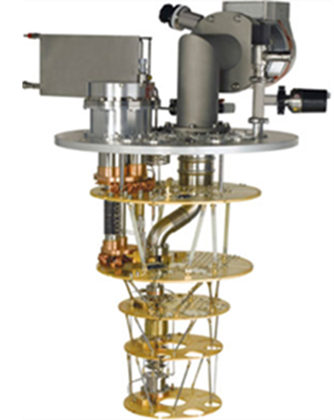
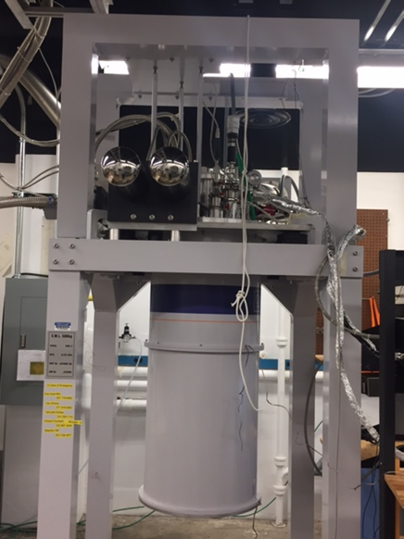
Scanning SQUID Microscopy --- current research
Our design utilizes a unique superconductor pickup loop fabricated on the corner of a Si wafer and coupled to a commercial SQUID sensor. This gives a good geometry for coupling to vortices and a sharp corner for close approach
SQUID coupling loop
flux bias path
1 μm
pickup loop
corner loop couples effectively to flux emanating from vortex
patterning by electron-beam lithography and focused ion-beam etching (FIB)
Scanner: Bimorph x-y scanner with an Attocube coarse positioner.
Approach: z-piezo with fiber-based laser interferometer for separation feedback
Cryostat: dry dilution refrigerator (Triton-200) with integrated transport leads for manipulation and measuremtns of MFs
Bimorph scanner
SSM and sample
z-piezo
Attocube positioner

Slide 19
SQUID applications
Applications in my own research:
sensitive detectors of voltage, current, magnetic field
transport properties of metals and superconductors
scanning SQUID microscopy – of arrays, vortices, etc.
SQUID interferometry --- pairing symmetry, current-phase relations, …
magnetic monopole detection in spin ices
dark matter detection
Current applications:
Geophysics
Non-destructive testing
Underwater communication --- submarines
Cosmology --- dark matter detectors, CMB measurements
Medical imaging
Low field NMR --- high contrast, don’t need high magnetic fields

Slide 21
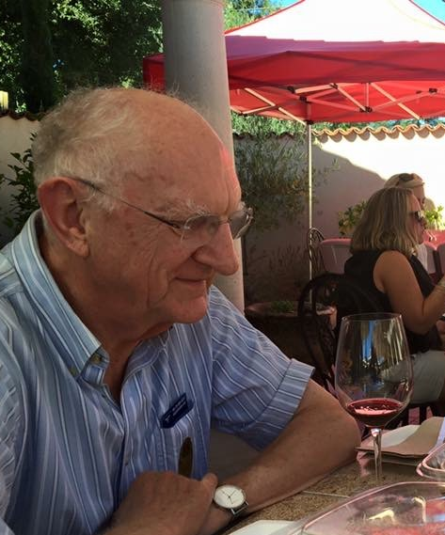
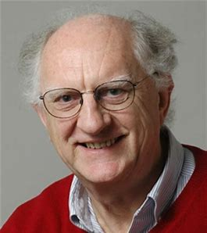
SQUID Applications
John Clarke
University of California, Berkeley
ISEC
(International Superconductive Electronics Conference)
Riverside, CA
27 July 2019

Slide 22
High-T_{c} SQUIDs: Prospecting for Mineral Deposits
SQUIDs
in
liquid N₂
Courtesy Cathy Foley, CSIRO
To date, this technique has discovered an estimated $10 billion of mineral deposits

Slide 23
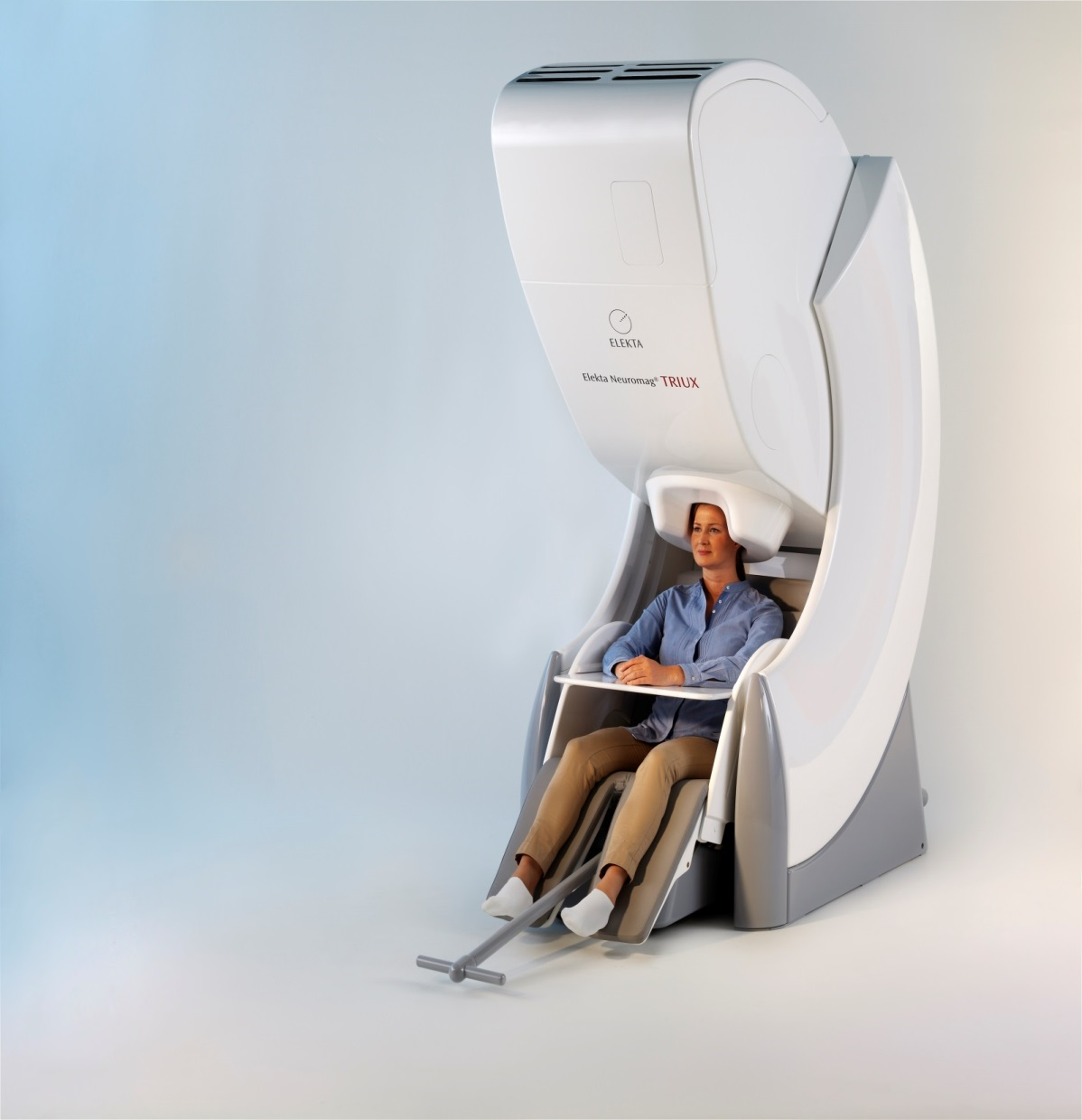
Magnetoencephalography (MEG
MEGIN*
*An Elekta Company
Approximately 125 MEGIN
systems worldwide
Courtesy Jukka Nenonen, MEGIN

Slide 24
MEGIN Silicon Chip Sensor Array
306 SQUID MEG channels:
102 magnetometers
  204 gradiometers
  Cooled to 4.2 K in fiberglass dewar
  Available with He gas recycling and cryocooler to avoid purchasing ongoing supply of liquid He
System surrounded by magnetically shielded room to attenuate external noise
Two basic modes
  Spontaneous magnetic brain signals
  Stimulated magnetic brain signals
Courtesy Jukka Nenonen, MEGIN

Slide 25
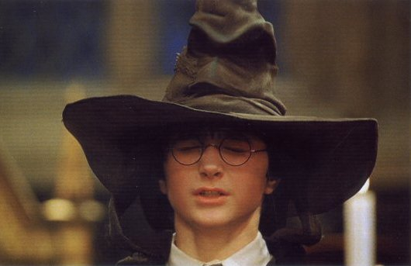
Harry Potter: The Sorting Hat
Which Hogwart’s House do you belong in?
“There is nothing hidden in your head
The Sorting Hat can’t see,
So try me on and I will tell you
Where you ought to be.”

Slide 26

The Science of Harry Potter
Roger Highfield, 2002
“The magnetic fields sprouting from Harry’s head influence the electron pairs circulating in the SQUIDs in the Sorting Hat. Because quantum mechanics says that all the electron pairs in each SQUID act in concert (in the jargon, all the electrons are in the same “quantum state”), they convert a tiny change in his brain’s magnetic field into a detectable change in voltage with a sensitivity unmatched by any other device.”

Slide 27
Our Bizarre Universe
Neutrinos 0.6%
Baryons (ordinary matter) 4.6%
Dark Energy (DE) 68.0%
Cold Dark Matter (CDM) 26.8%
Thus 95% of the universe is unknown!
SQUIDs are being used to investigate
both DE and CDM

Slide 28
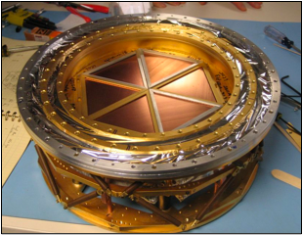
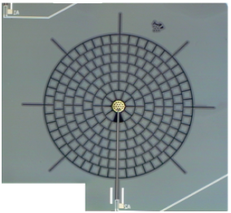
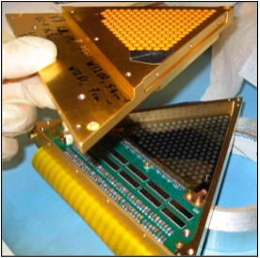
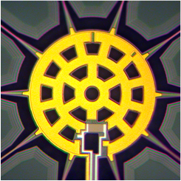

South Pole Telescope TES Detector Array (2006)
SPT focal plane
(960 detectors at 0.25 K)
Detector: 5-mm diameter
“spiderweb” that absorbs
microwaves
TES 25 μm across
Wedge with
160 detectors
Courtesy Hsiao-Mei Cho, SLAC

Slide 29
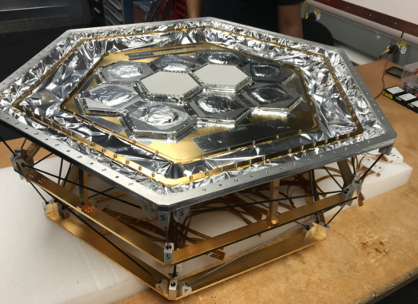
SPT-3G (2017)
Argonne National Laboratory
16,000 TESs
Multiplexing factor 68
24,000 SQUIDs
Courtesy Hsiao-Mei Cho, SLAC

Slide 30
The Axion
Neutrinos 0.6%
Baryons (ordinary matter) 4.6%
Dark Energy (DE) 68.0%
Cold Dark Matter (CDM) 26.8%
A highly motivated candidate particle for CDM is the axion.
The axion is a hypothetical elementary particle postulated by the Peccei–Quinn theory in 1977 to resolve the strong CP (charge conjugation and parity) problem in QCD (quantum chromodynamics).
Would also explain the absence of a measurable electric dipole moment on the neutron.
Alternative CDM candidate: WIMP (Weakly Interacting Massive Particle).

Slide 31
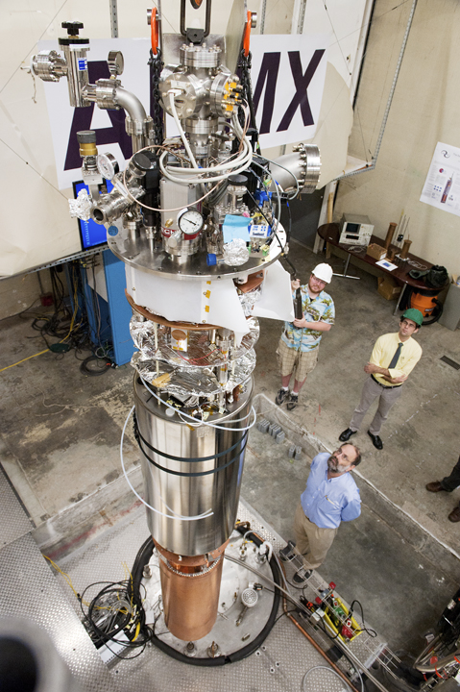
ADMX Today
Magnetic field 7 T
Cavity temperature 150 mK
University of Washington, Seattle
Courtesy Leslie Rosenberg, U. of Washington

Slide 32
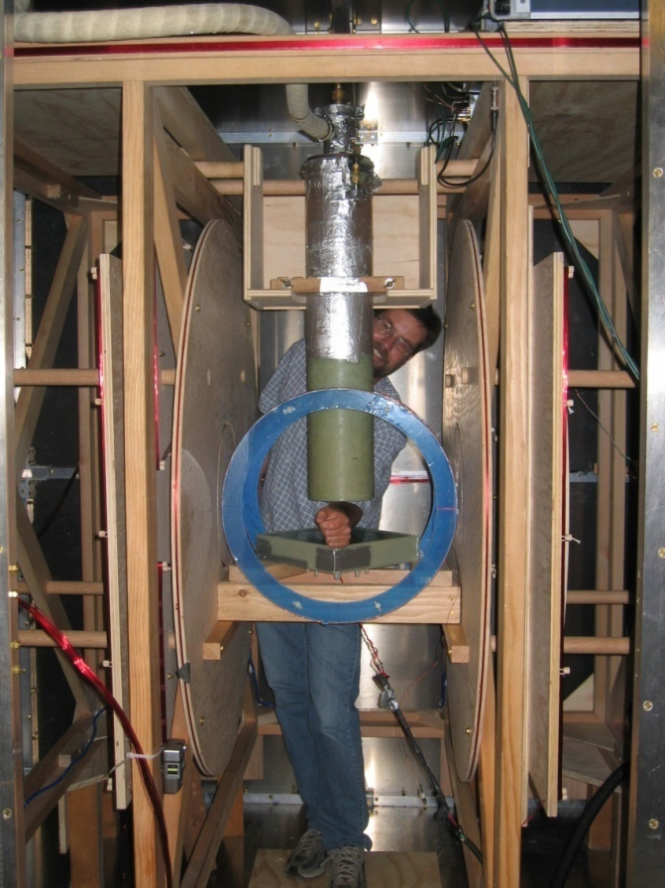
ULF MRI Coil Geometry
B_{x} compensation coil
Low noise cryostat containing SQUID
second derivative gradiometer
Gradient coils
B₀ coil (measurement field)
B₁ coil (excitation field)
B_{p} coil (prepolarization field)
B₀ = 132 μT
ν₀ = 5600 Hz
Spatial encoding for magnetic resonance imaging provided by gradient magnetic fields

Slide 33
SQUID-Based Second Derivative Gradiometer
Current limiting
Josephson tunnel junctions
700 Ω normal resistance
1 mm
Input coil
I
b
I
b
Superconducting
shields
SQUID
Nb wire,
second order gradiometer:
baseline = 76 mm
diameter = 63 mm
Magnetic field noise: 0.7 fT Hz^{-1/2}
referred to bottom loop
B
x
M
0
z
y
Notes:
Here is a schematic of our detection scheme.
Here is our SQUID, and here are the two Josephson junctions.
In order to transform the SQUID from a sensitve detector of magnetic flux into a sensitive detector of magnetic fields, we connect the superconducting niobium input coil patterned on top of the SQUID to a superconducting gradiometer.
When a magnetic field from the precessing spins impinges on the bottom loop of the gradiometer, flux conservation causes a supercurrent to flow, coupling flux into the SQUID, which is then detected.
In contrast, homogeneous fields or first derivative fields couple no net flux into the gradiometer and are thus not detected by the SQUID. Because higher-order gradient fields from distant noise sources fall off rapidly with distance, the gradiometer discriminates against them.
In order to protect the SQUID from the polarization pulse, we insert superconducting Josephson tunnel junctions into the gradiometer circuit and we enclose the SQUID in a superconducting shield. Without this protection, the polarizing pulse would cause ~40 A of current to flow through the gradiometer.

Slide 34
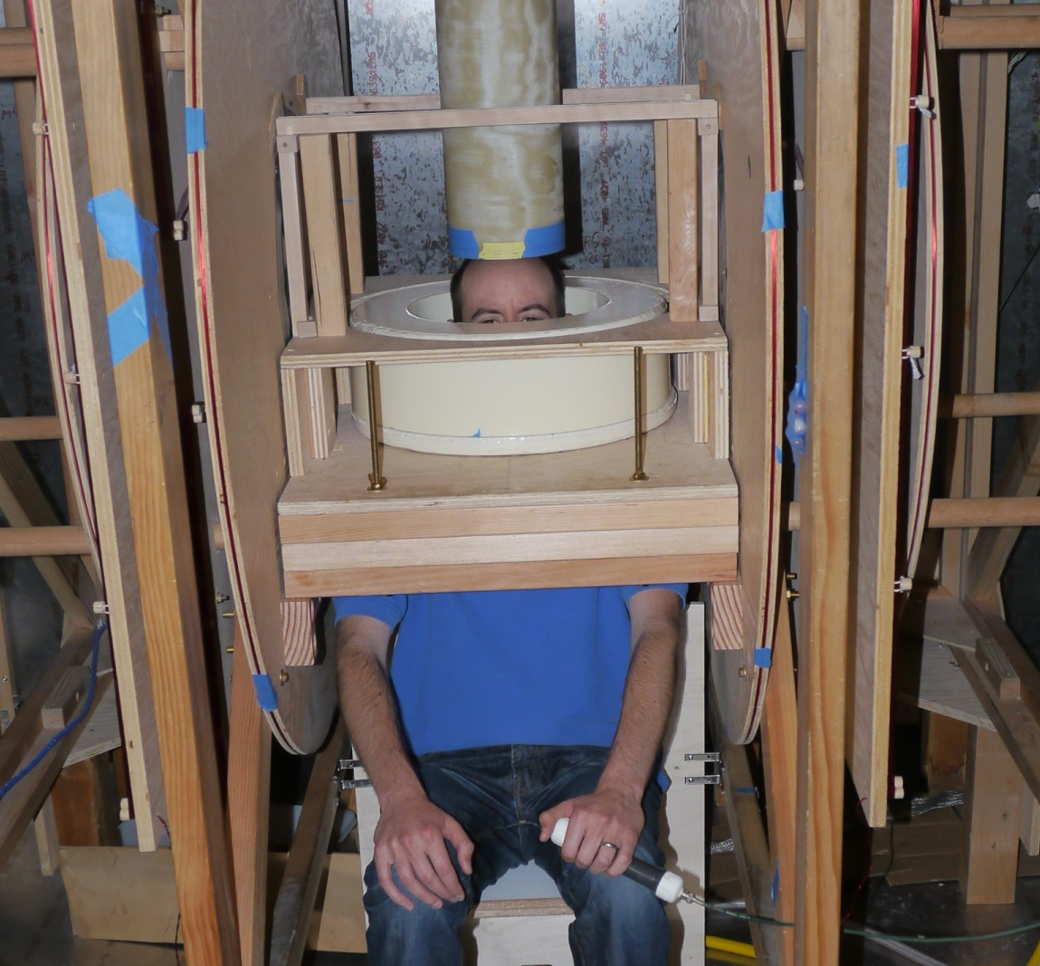
ULFMRI System for Brain Imaging
Fiberglass dewar
B₁ coil (excitation field)
Polarizing coil
dB_{z}/dz gradient coil
dB_{z}/dx gradient coil
B₀ coil (measurement field)
Safety button
Magnetometer noise 0.7 fTHz^{-1/2}
Polarizing field at the brain 80 mT

Slide 35
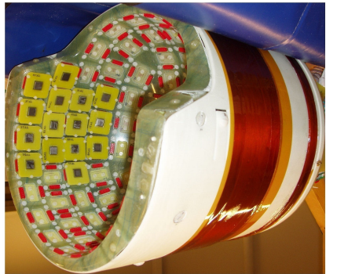
European Project
BREAKBEN
Breaking the Nonuniqueness Barrier in Electromagnetic Neuroimaging
System contains 120 SQUIDs to detect both MEG and ULFMRI
Large number of SQUIDs substantially enhance SNR of ULFMRI
ULFMRI enables accurate co-registration of MEG sources
Two imaging modalities for the price of one (almost)!
New generation will have more channels, lower SQUID noise
Risto Ilmoniemi
Aalto University,
Finland

Slide 36
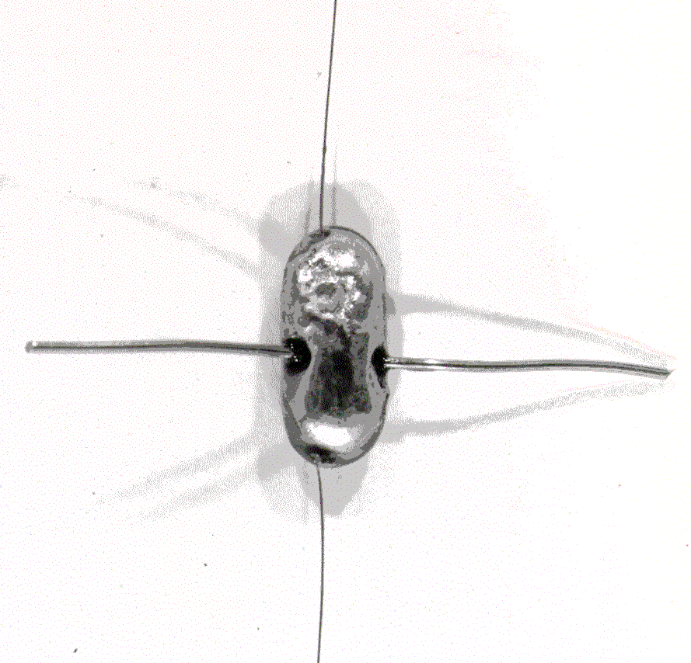
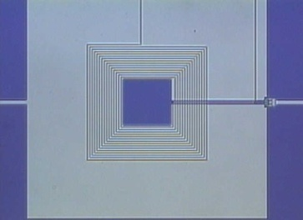
Epilogue
SQUIDs are amazingly diverse, with applications in
physics, chemistry, biology, medicine, materials science,
geophysics, cosmology, quantum information,……..
SQUIDs are remarkably broadband: 10⁻⁴ Hz (geophysics)
to 10⁹ Hz (axion detectors).
At low temperatures, the resolution of SQUID amplifiers is essentially limited by Heisenberg’s Uncertainty Principle.
Looking for galaxy clusters, the axion search, MEG and ULFMRI are examples of a host of applications that exist only because of the extraordinarily low noise of the SQUID.

